Slide 1
Microsoft Azure Administration | Development
Modul 1 – Microsoft Azure| Einführung und Überblick

Slide 2
Inhalte
Einführung
01
RBAC
Policies
03
Lab INTRO.1
Lab INTRO.2
04
Azure Portal
02

Slide 3
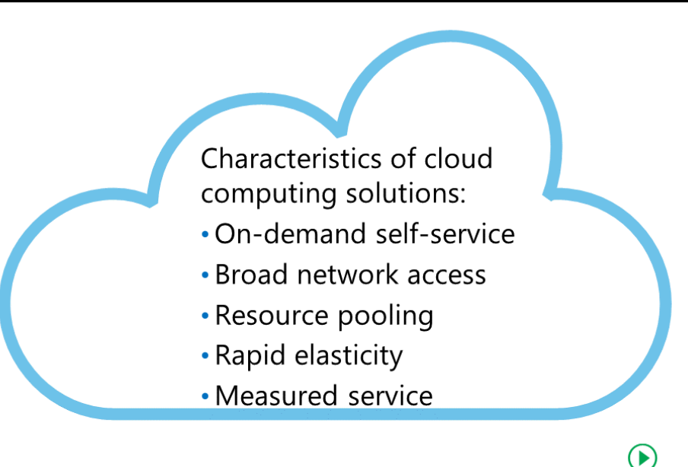
Cloud Computing

Slide 4
Vorteile
?
Notes:
Fully managed data center / service
Minimal capex
Better speed and flexibility
Virtualization and server consolidation
-> Braucht eigene deployment modelle (DevOps, Infrastructure as code,..)

Slide 5
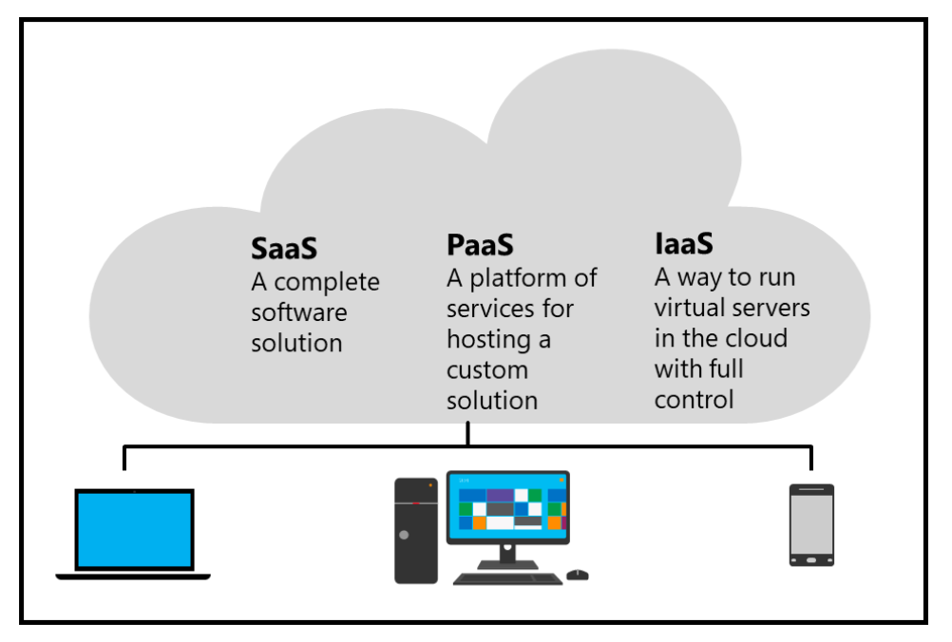
Cloud Services
Notes:
PaaS : ZB Azure App Service
IaaS: zB VM Service, Aber auch SQL,..

Slide 6
Microsoft Azure - Einführung

Slide 7
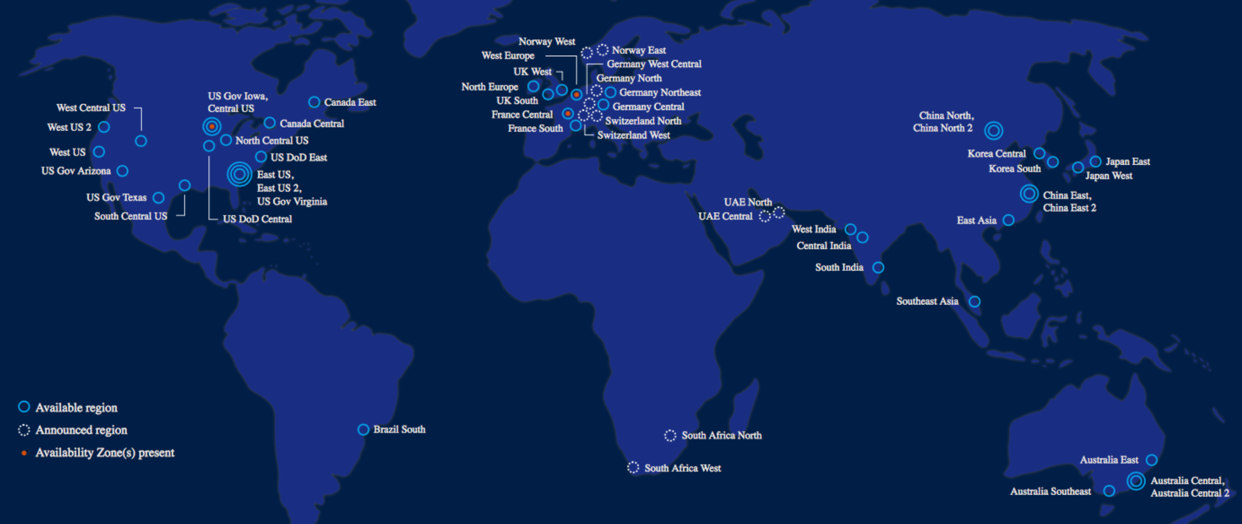
Microsoft Azure Map

Slide 8
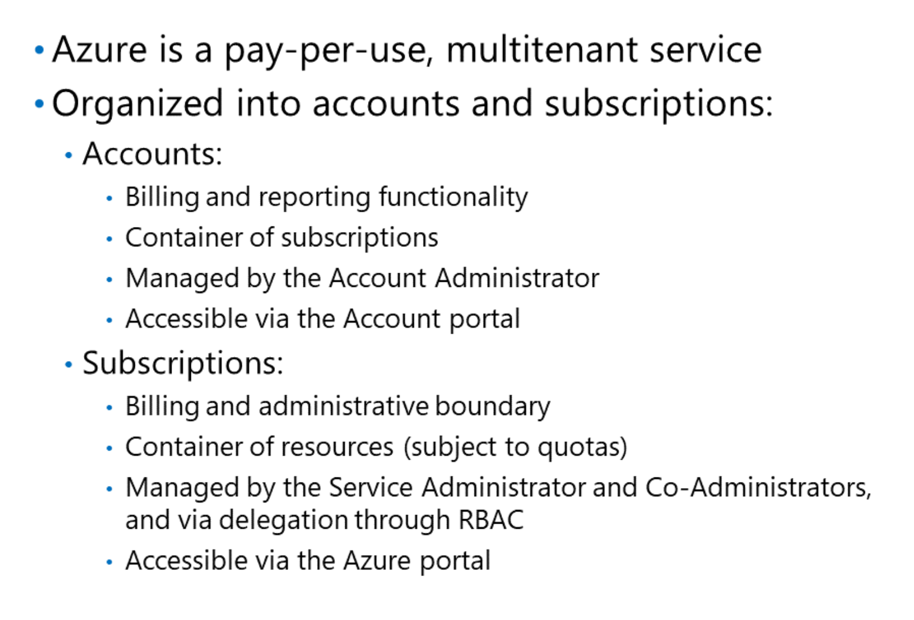

Microsoft Azure Service
Weiterführende Informationen > https://aka.ms/lxo0an
Notes:
Demonstrate in Azure Portal
Show RBAC to andreasaschauer@andreasaschauer.onmicrosoft.com

Slide 9
Administrative Rollen
Account Administrator > Account
Service Administrator > Subscriptions
Co-Administrator > Resourcen
Notes:
Account Admin: https://account.windowsazure.com/Subscriptions

Slide 10
Azure Resourcenkosten
Azure Pricing Calculator > https://aka.ms/lyvi3b

Slide 11
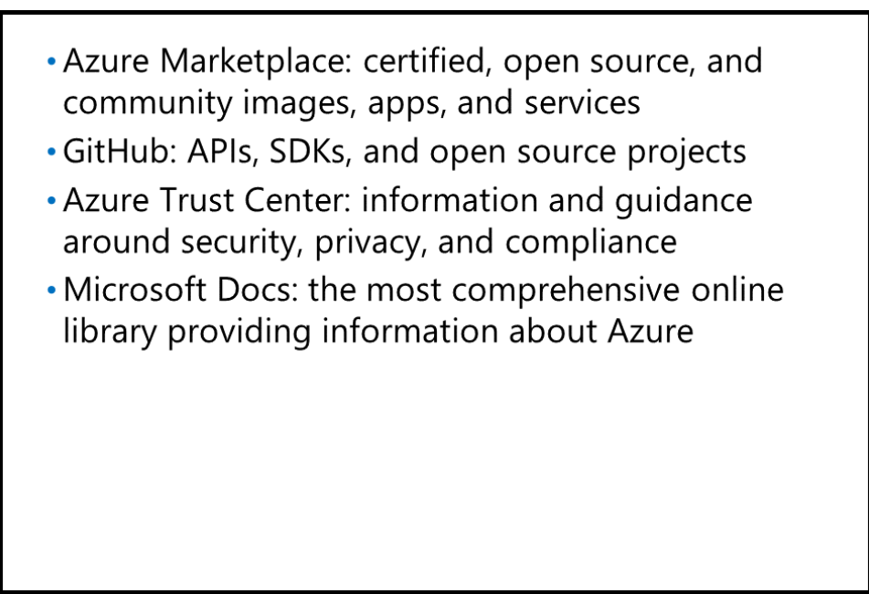
Hilfe !

Slide 12
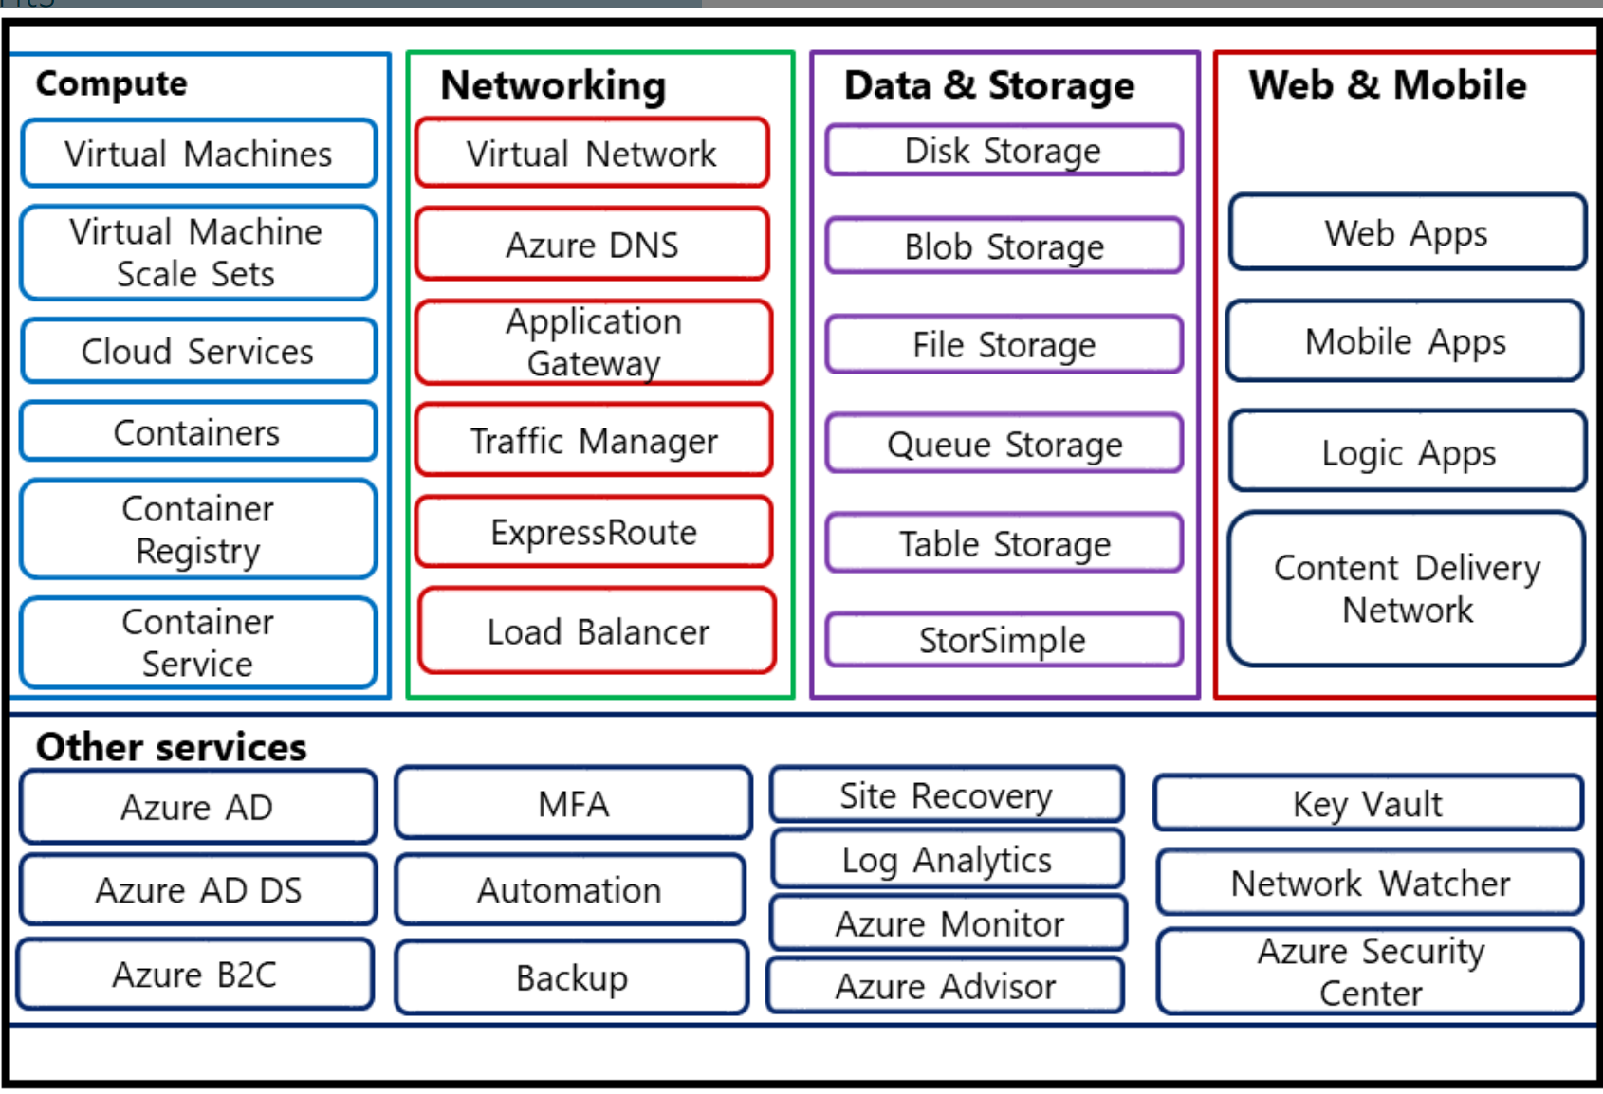
Azure Services

Slide 13
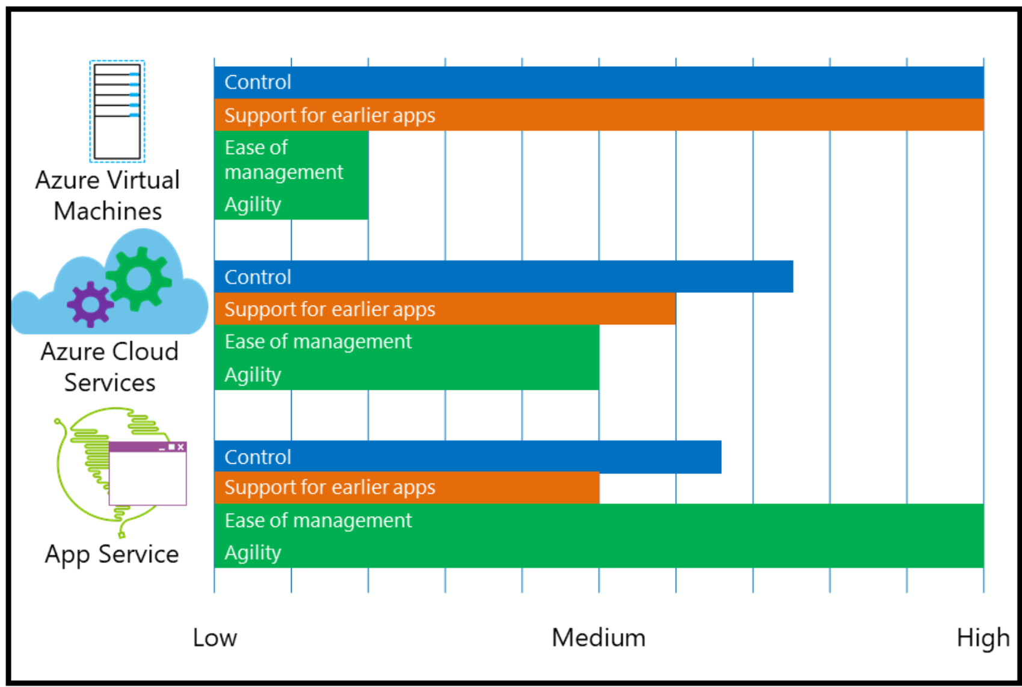
Azure Compute
Notes:
You can use App Service to quickly provision and create web, mobile, logic, or API apps in Azure. App Service is a PaaS solution,
Cloud Services
Azure Cloud Services offers multitier scalability for Windows-based web apps and greater control over the hosting environment. When using Azure Cloud Services, you can connect to your virtual machines and interactively perform management tasks such as registry modifications and Windows Installer–based installations. You typically use Azure Cloud Services to deploy more complex solutions than an App Service can provide. Azure Cloud Services is best suited for:
•
Multitiered web apps.
•
Web apps that require a highly scalable, high-performance environment.
•
Web apps that have additional application dependencies or require minor operating system modifications.

Slide 14
Azure Compute Application Hosting
VMs | Container | Functions
Teil des Hyper-V | Setzt auf OS auf | Einzelne Services
Inkludiert OS | Nur App Komponenten | Nur 1 Funktion – mehrere Functions zusammen bilden komplett Funktion ab
Start - Langsam | Start – Schnell | n/a
Automation komplex | Einfache Orchestrierung | n/a

Slide 15
Microsoft Azure Portal

Slide 16
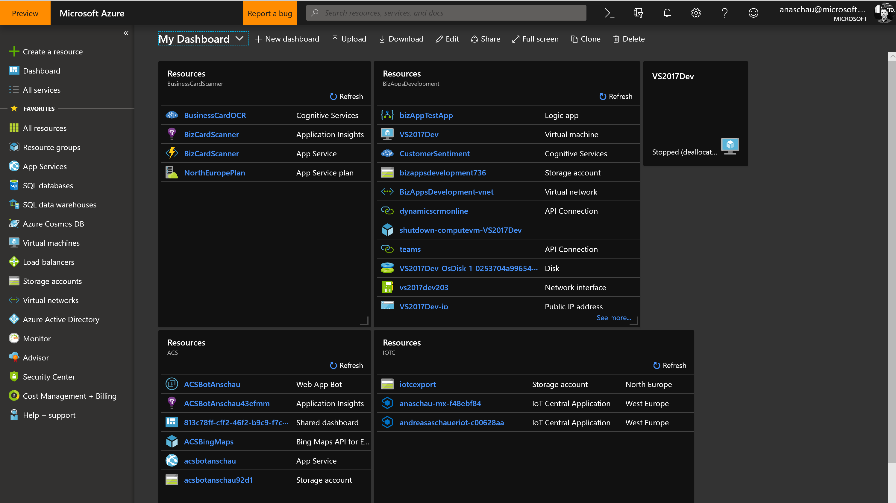
Notes:
Hub Menu / Dashboards

Slide 17
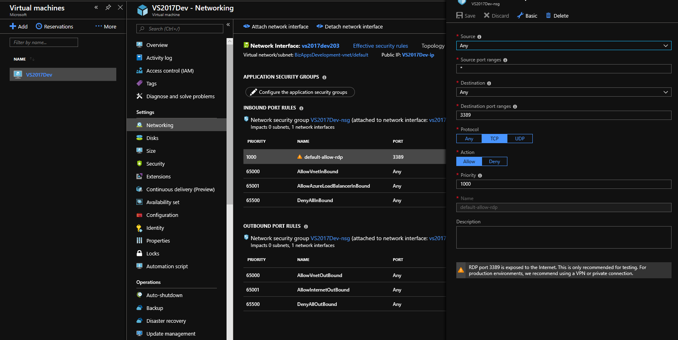
Notes:
Blades

Slide 18
Lab INTRO.1: Azure Portal

Slide 19
Microsoft Azure Ressourcen & Resource Manager

Slide 20
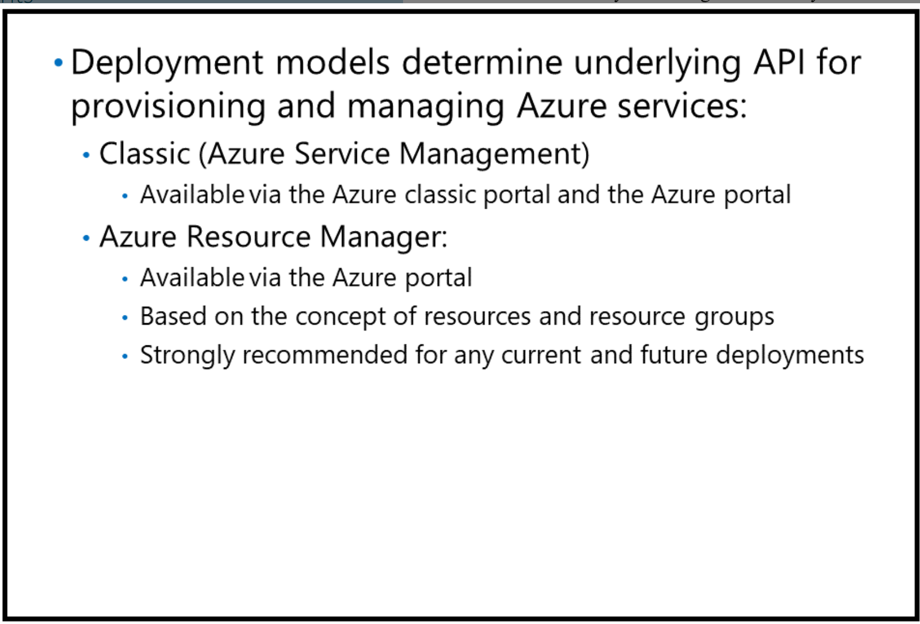
Azure Deployment Modelle

Slide 21
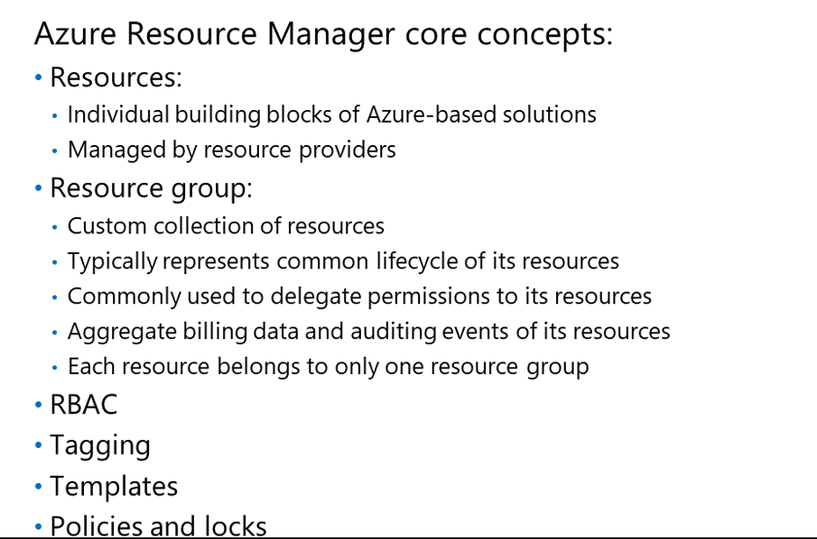
Azure Resource Manager

Slide 22
Microsoft Azure RBAC | Tags | Policies | Locks

Slide 23
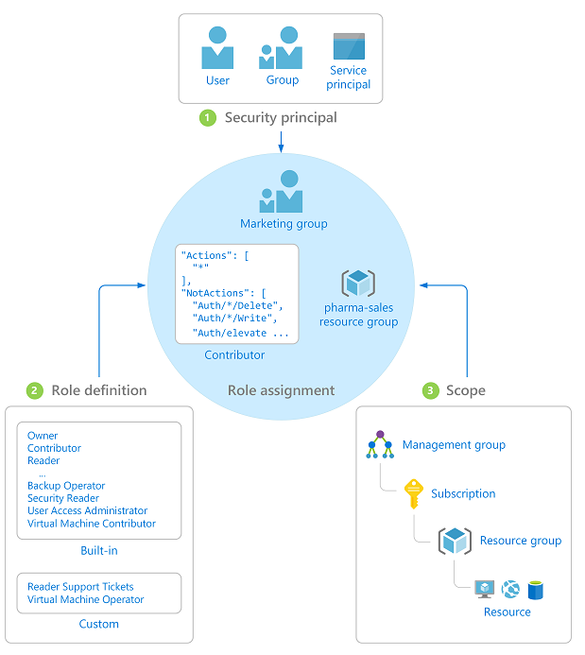
RBAC

Slide 24
Tagging
Tags erlauben die Gruppierung von Resourcen zu mehr als einem “Konzept” bzw. Über Resourcengruppen hinweg

Slide 25
Policies / Locks
Erlauben die Definition von “Einschränkungen” für Ressourcen Deployments.
> Compliance Vorgaben!
Notes:
Definition der Policy Allowed Location -> zuweisen zur Resourcengruppe “AzureTraining”

Slide 26
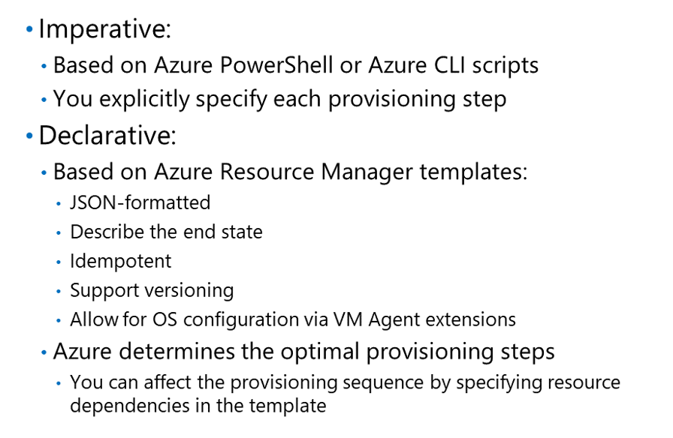
ARM Deployments
Notes:
Definition der Audit Location Policy + JSON Demo

Slide 27
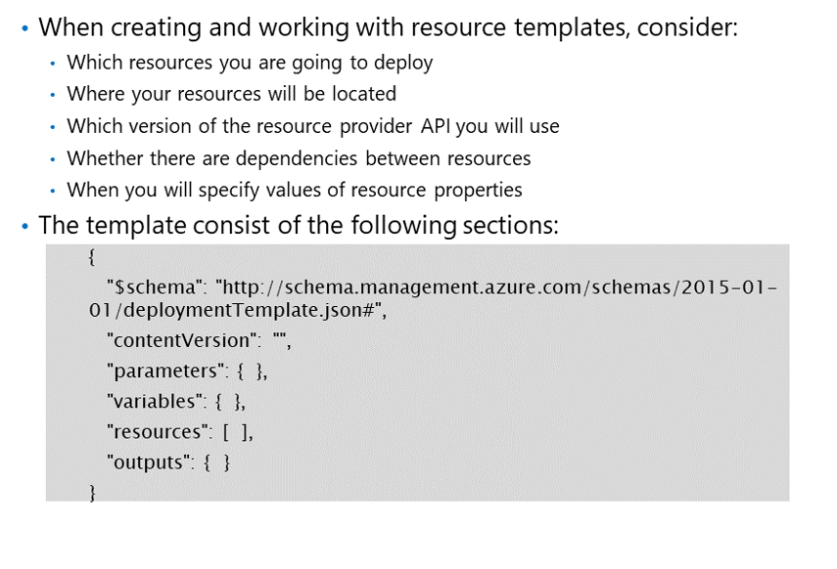
ARM Templates
https://github.com/Azure/azure-quickstart-templates
Notes:
https://github.com/Azure/azure-quickstart-templates/tree/master/101-1vm-2nics-2subnets-1vnet
ARMVIZ

Slide 28
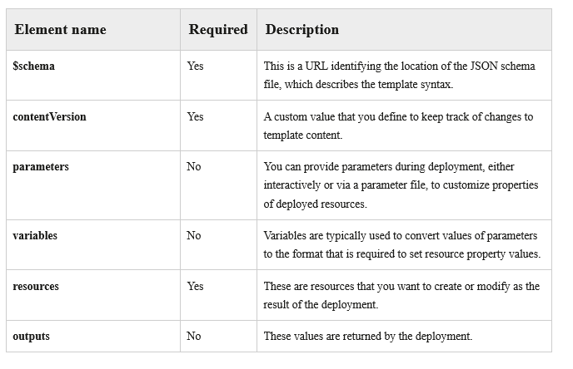
ARM Template - Bestandteile
http://aka.ms/Jcr7f7.
Notes:
C:\Users\anaschau\OneDrive\Training\Inhouse\Comparex\ArmTemplateWithCode.code-workspace

Slide 29
DEMO: Deployment von ARM Templates
Notes:
https://github.com/Azure/azure-quickstart-templates/tree/master/101-1vm-2nics-2subnets-1vnet
ARMVIZ

Slide 30
Lab INTRO.2: RBAC | Policies | Locks | Tags

Slide 31
Fragen?

